Slide 1
Face Recognition
Using Principal Components Analysis (PCA)

Slide 2
Outline
What is face Recognition ?
Principal Components Analysis (PCA)
Shortest Euclidean Distance Classifier
Dataset
Matlab

Slide 3
What is face recognition ?
face recognition is a type of biometric software application that can identify a specific individual in a digital image by analyzing and comparing patterns.

Slide 4
What are biometrics ?
A biometric is a unique, measurable characteristic of a human being that can be used to automatically recognize an individual or verify an individual identity. Biometrics can measure both physiological and behavioral characteristics. Physiological biometrics (based on measurements and data derived from direct the human body) include:
Finger-scan
Facial Recognition
Iris-scan
Retina-scan
Hand-scan.

Slide 5
Applications
Security/Counterterrorism. Access control, comparing surveillance images to Know terrorist.
Day Care: Verify identity of individuals picking up the children Residential Security: Alert homeowners of approaching personnel .
Banking using ATM: The software is able to quickly verify a customer’s face.

Slide 6
Implementation
The implementation of face recognition technology includes the following four stages:
Image acquisition
Image processing
Distinctive characteristic location
Template creation
Template matching

Slide 7
Image Acquisition
Facial-scan technology can acquire faces from almost any static camera or video system that generates images of sufficient quality and resolution.
High-quality enrollment is essential to eventual verification and identification enrollment images define the facial characteristics to be used in all future authentication events.

Slide 9
Image Processing
Images are cropped such that the ovoid facial image remains, and color images are normally converted to black and white in order to facilitate initial comparisons based on grayscale characteristics.
First the presence of faces or face in a scene must be detected. Once the face is detected, it must be localized and Normalization process may be required to bring the dimensions of the live facial sample in alignment with the one on the template.

Slide 10
Distinctive characteristic location
All facial-scan systems attempt to match visible facial features in a fashion similar to the way people recognize one another.
The features most often utilized in facial-scan systems are those least likely to change significantly over time: upper ridges of the eye sockets, areas around the cheekbones, sides of the mouth, nose shape, and the position of major features relative to each other.

Slide 11
Behavioral changes such as alteration of hairstyle,
changes in makeup, growing or shaving facial hair,
adding or removing eyeglasses are behaviours that
impact the ability of facial-scan systems to locate
distinctive features, facial-scan systems are not yet
developed to the point where they can overcome
such variables.

Slide 12
Template Creation

Slide 13
Template Matching
It compares match templates against enrollment templates.
A series of images is acquired and scored against the enrollment, so that a user attempting 1:1 verification within a facial-scan system may have 10 to 20 match attempts take place within 1 to 2 seconds.
facial-scan is not as effective as finger-scan or iris-sscan in identifying a single individual from a large database, a number of potential matches are generally returned after large-scale facial-scan identification searches.

Slide 14
PCA

Slide 15
Principal Components Analysis ( PCA)
An exploratory technique used to reduce the dimensionality of the data set to 2D or 3D
Can be used to:
Reduce number of dimensions in data
Find patterns in high-dimensional data
Visualize data of high dimensionality
Example :
Face recognition
Image compression
Gene expression analysis

Slide 16
How is PCA used in Recognition?
A training set is used for learning phase
Applying PCA to training data to form a new coordinate system defined by significant Eigen vectors
Representing each data in PCA coordinate system (weights of Eigen vectors)

Slide 17
A test set is used for testing phase
Same PCA coordinate system is used
Each new data is represented in PCA coordinates
New data is recognized as the closest training data (Euclidean distance)

Slide 18
Steps of PCA

Slide 19
1.Let be the mean vector
(taking the mean of all rows)
2.taking the mean of all rows)
X’ = X –

Slide 20
3. Compute the covariance matrix C
of adjusted X .
4. Find the eigenvectors and eigenvalues of C.

Slide 21
5.For matrix C, vectors e (=column vector) having same direction as Ce :
eigenvectors of C is e such that Ce=λe
λ is called an eigenvalue of C.

Slide 22
Ce=λe ⇔ (C-λI)e=0
6.Calculate eigenvalues λ and eigenvectors x for covariance matrix

Slide 23
PCA Applications
Data Visualization
Data Compression
Noise Reduction
Data Classification
Trend Analysis
Factor Analysis

Slide 24
Shortest Euclidean Distance Classifier

Slide 25
Euclidean Distance
Where n is the number of dimensions (attributes) and p_{k} and q_{k} are, respectively, the k^{th} attributes (components) or data objects p and q.
Standardization is necessary, if scales differ

Slide 26
Euclidean Distance
Distance Matrix

Slide 27
Dataset

Slide 28
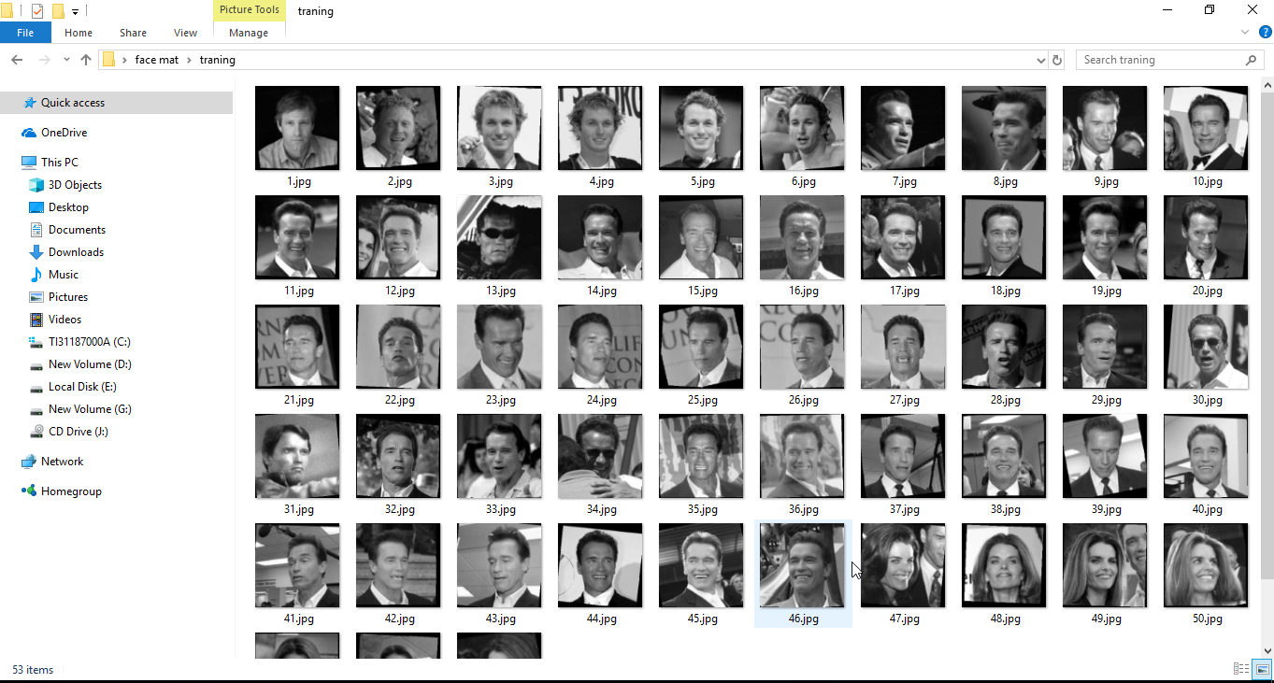
Training Image

Slide 29

Testing Image

Slide 30

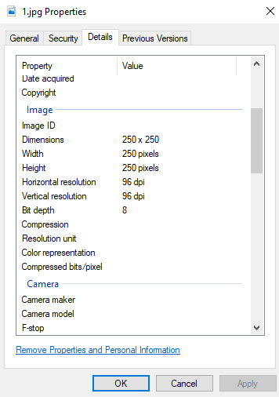
Image details

Slide 31
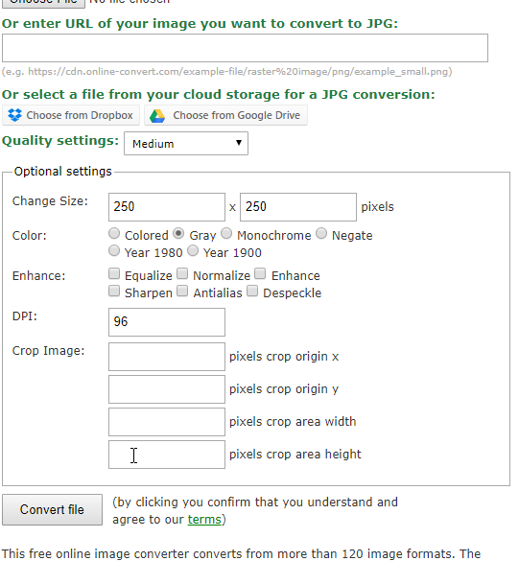
Make Dataset
https://image.online-convert.com/convert-to-jpg

Slide 32
MATLAB

Slide 33
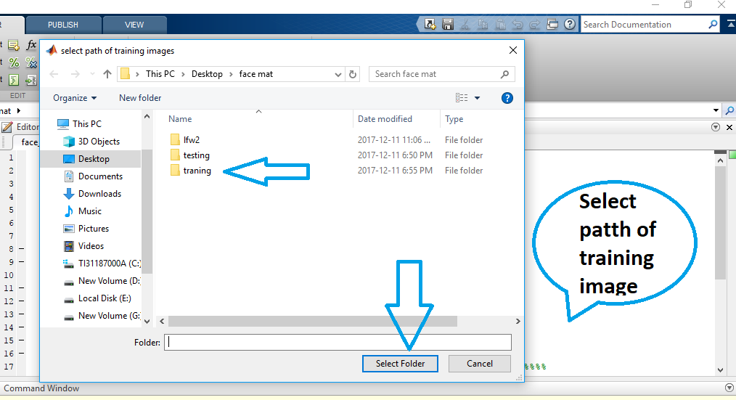
1.

Slide 34
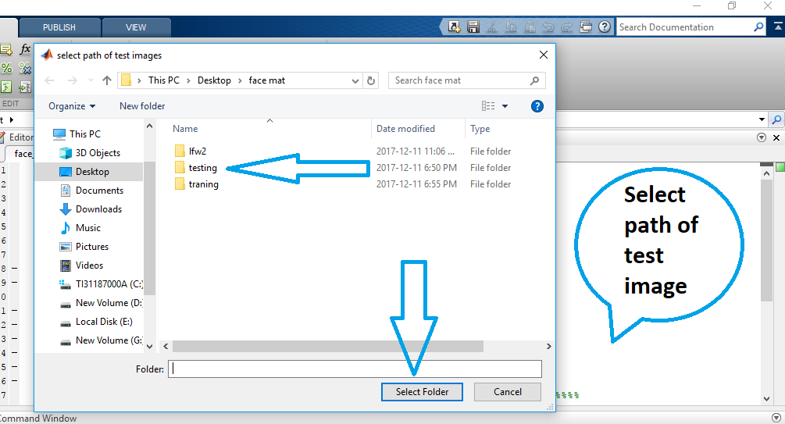
2.

Slide 35
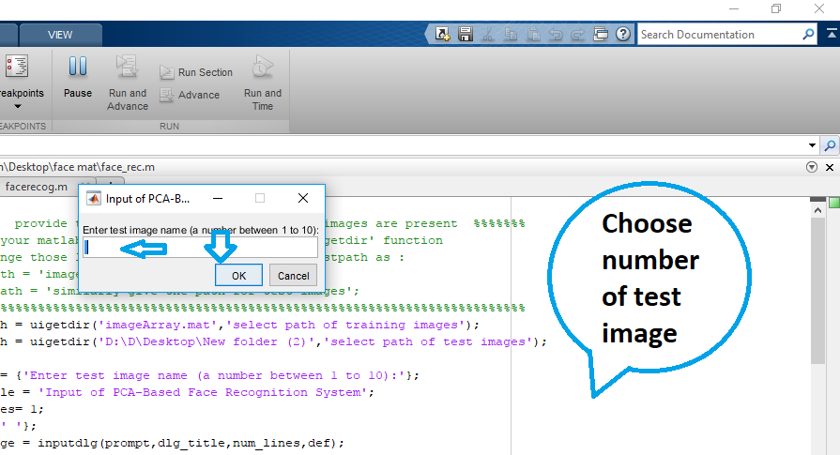
3.

Slide 36
Some Examples

Slide 37
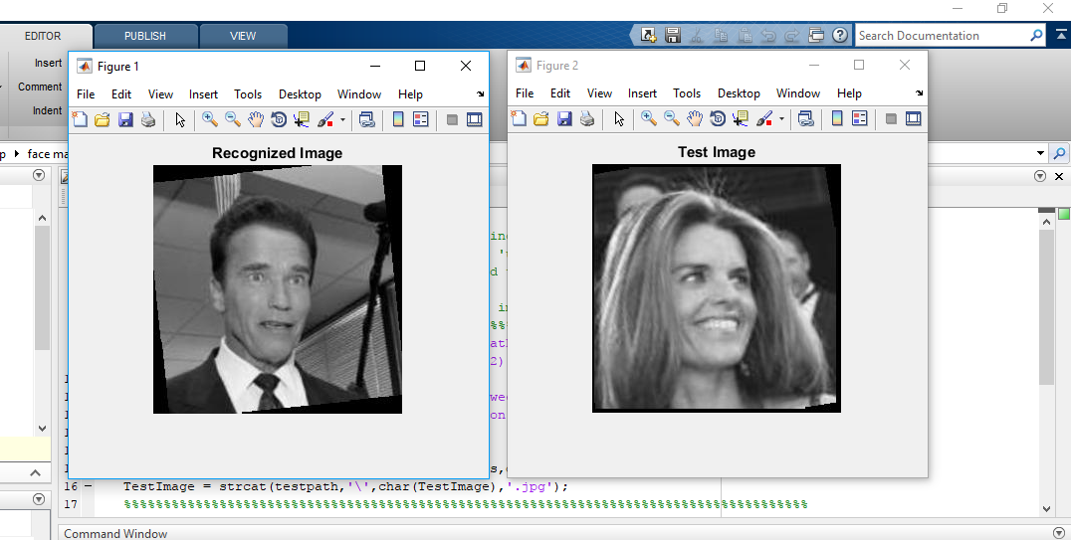
Why ??

Slide 38
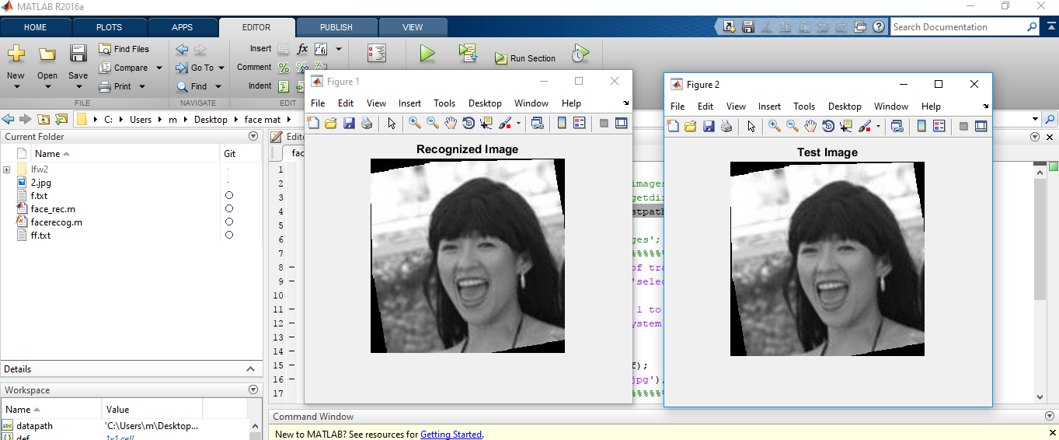
Why ??

Slide 39
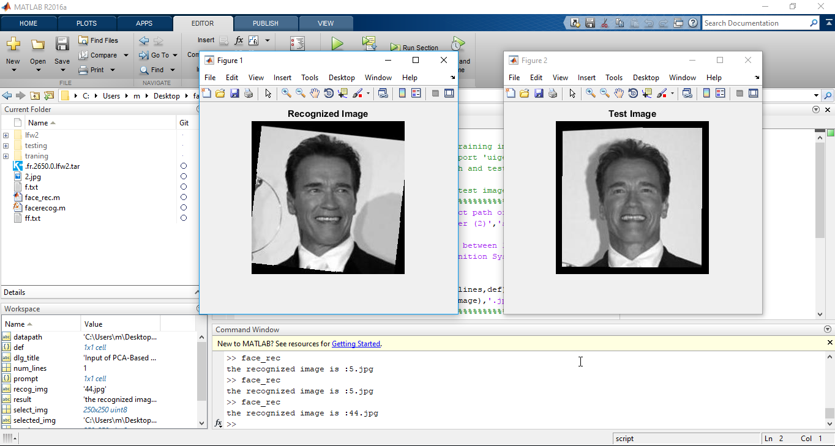
Why ??

Slide 40
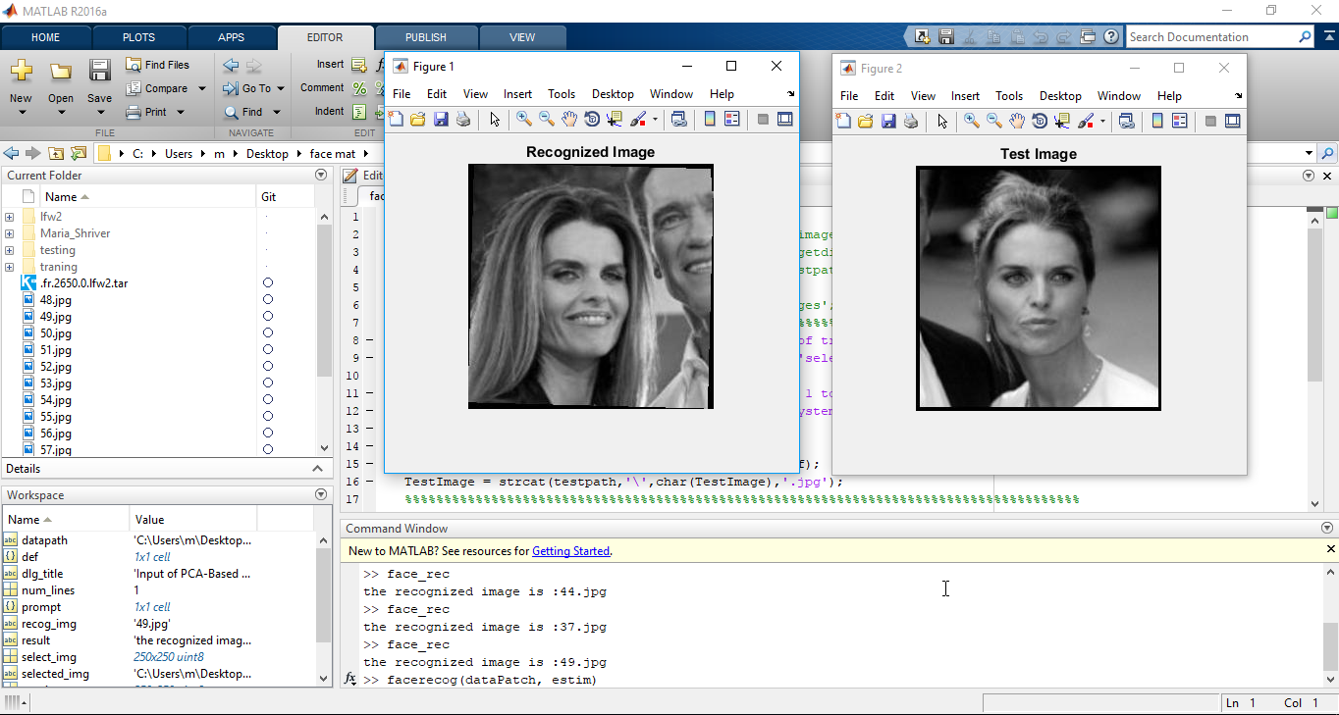

Slide 41
Thanks

